Slide 1

Dagu Thumper Controller using ESP32 Web Server
CSCE 4301 Project 2
Ashraf Ibrahim 900152964
Nourhan Mokbel 900162020
Saif El Din Abbas 900161322
The American University in Cairo

Slide 2
Agenda
Introduction
Application Flow
Initial Design
Required Components

Slide 3
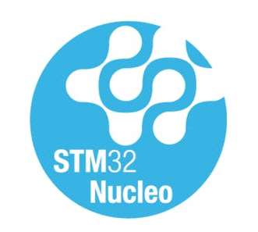
Introduction
Main Idea
What is the ESP32?
ESP32 Data Acquiring
Web Server
Cloud Server
Notes:
u

Slide 4


Application Flow
HC-SR04
Rx
Tx
WiFi
UART
UART
ESP32
IP
Dagu Thumper
ESP32
STM32

Slide 5
Hardware Interface
HC-SR04
Echo
Trig
Tx
D9
D10
ESP32
UART2
UART1
Dagu Thumper
TX2
A2
D0
TX
RX2
A7
D1
RX
STM32

Slide 6
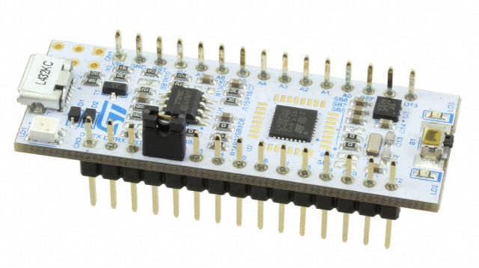
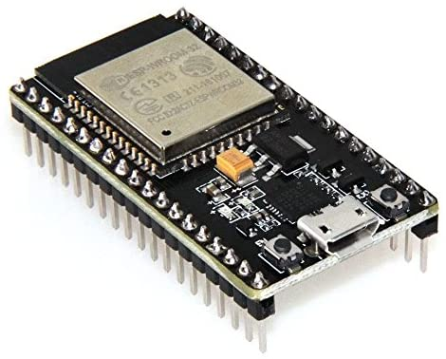
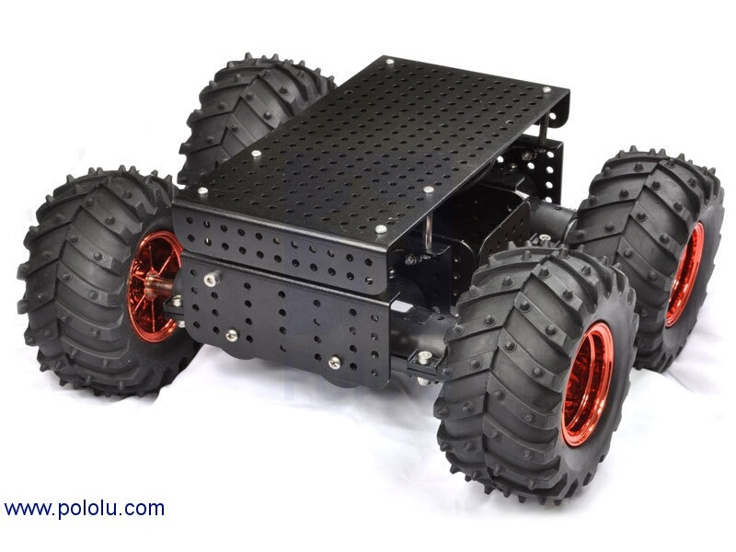
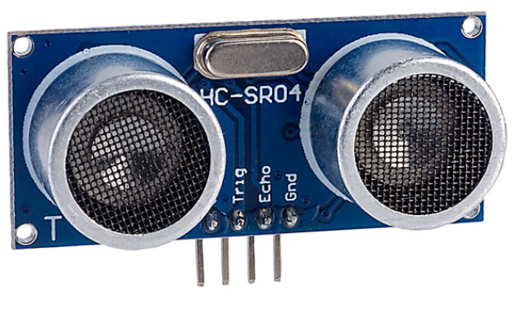
Required Components
STM32 Nucleo Board (L432KC)
ESP32 Node
HC-SR04 Ultrasonic Sensor
Dagu Thumper
Pololu TReX Motor Controller

Slide 7
Thank You!

